Slide 1
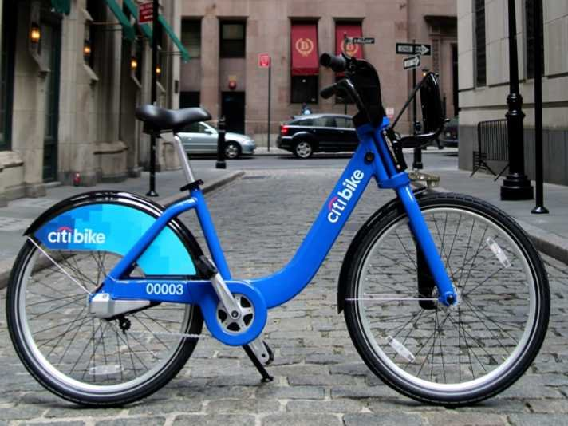
Citi Bike NYC
Letting you ride bikes
from whatever station to whatever station
since July 2013
Notes:
Might as well start with torque map from CartoDB loaded up.

Slide 2
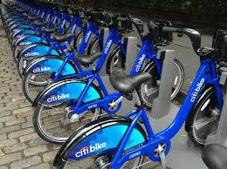
Citi Bike Background
Citi Bike stocks hundreds of stations with bicycles.
Annual subscribers and short-term customers borrow bikes from any station and return them to any station.
This adds up to tens of thousands of rides per day.

Slide 3
Citi Bike Data
Citi Bike has made available data describing every ride taken from July 2013 to February 2014.
This data includes the time and station of departure and arrival (as well as some other variables).

Slide 4
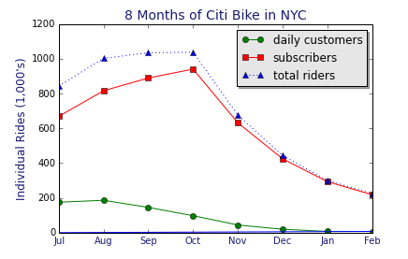
Notes:
The program has been really successful.
‘Daily’ customers = actually daily & weekly. $10/day or $25/week instead of $95/year.
Customers are potentially more profitable for subscribers Citi Bike, and daily and weekly rentals have not performed as well as projected.
However, they’ve had more subscribers than projected.

Slide 5
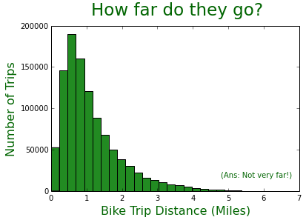
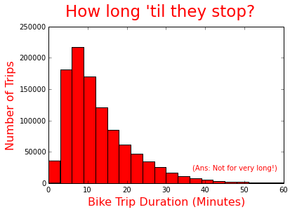
October 2013: Trips are short (as the crow flies)
Notes:
What do people do with Citi Bikes? They go mostly for very short trips.
Do regular subscribers & short-term customers use bikes much differently?

Slide 6
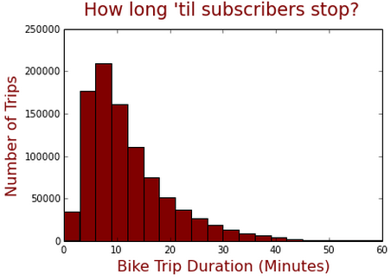
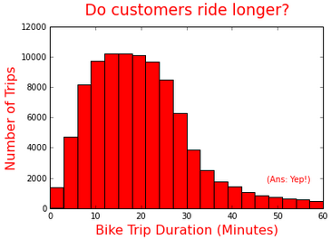
October 2013:
Subscribers know when to say when.
19.1%
0.7%
Mean = 12m, 33s
Mean = 25m, 31s
Notes:
95.7% of subscribers ride for less than 30 minutes. (under the customer max)
91.8% of customers ride for less than 45 minutes. (under the subscriber max)

Slide 7

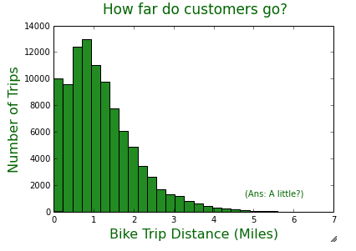
October 2013:
Short-Term Customers Bike Slightly Farther
Mean = 1.11 miles
Mean = 1.18 miles
Notes:
And there’s no good reason for it.
These numbers tend to underestimate actual distances, since distance is being calculated as the crow flies.
Time limit before incurring greater expenses is 45 minutes for subscribers, 30 minutes for short-term customers.

Slide 8
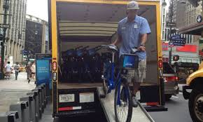
Citi Bike Background: An Inventory Issue
Since there is no control over who brings bikes where, riders tend to move bikes away from where they want them to be.
Riders also fill up docks where they want to stop.
Citi Bike is “‘experimenting with using bike trailers for rebalancing’ — moving bikes from stations with no empty slots to docks in other areas.”*
*http://www.nydailynews.com/new-york/citi-bike-issues-linger-article-1.1832298
Notes:
Add at the end: With thousands of bikes and hundreds of stations in a very dense city,
the task is enormously expensive and difficult.

Slide 9
Citi Bike Data Analysis: Goals
To describe & visualize the balancing of bicycle movements across the system in a meaningful and intuitive manner.
To illustrate and differentiate bike movements in specific stations.
To generate insight into how Citi Bike can go about rebalancing stations.
Notes:
Add at the end: With thousands of bikes and hundreds of stations in a very dense city, the task is expensive and difficult.

Slide 10
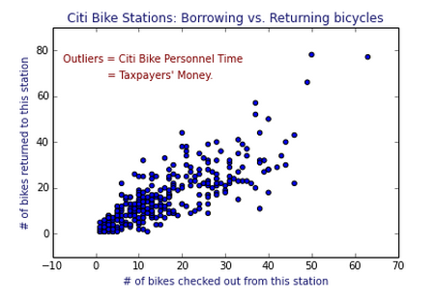

Slide 11
Citi Bike Ride Imbalances: July 2013 to February 2014
Green = More going (departures)
Red = More stopping (arrivals)
Beige = Not much difference either way
Notes:
Stations people leave from more than they arrive: -11271, -9980, -8188, -4857, -4570
Stations people arrive at more than they go: [2463, 2477, 2665, 2885, 4439]

Slide 12
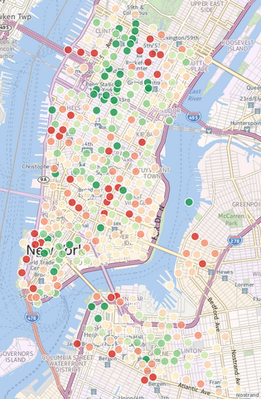
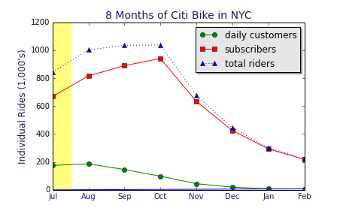
July
~850,000
rides
Notes:
SHOW TORQUE MAP
Since torque map didn’t work, I created my own “animation.”
Explain what this is: Map of monthly imbalances between comings and goings.

Slide 13
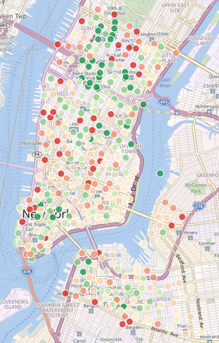
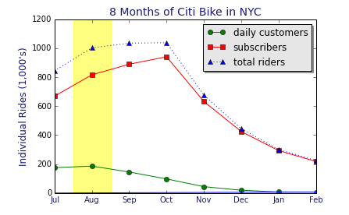
August
>1 million
rides

Slide 14
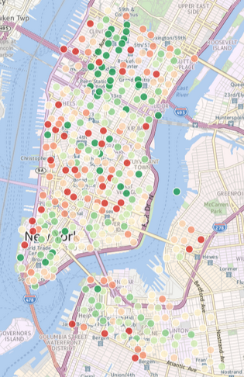
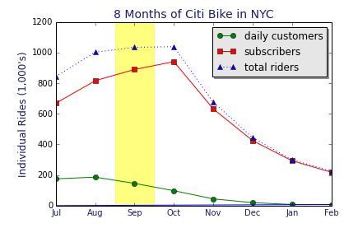
September
>1 million
rides

Slide 15
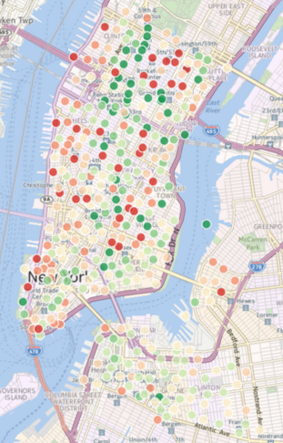
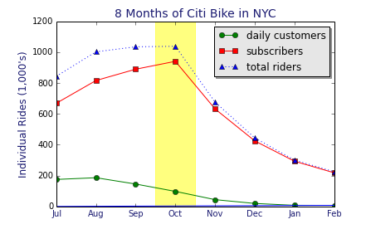
October
>1 million
rides

Slide 16
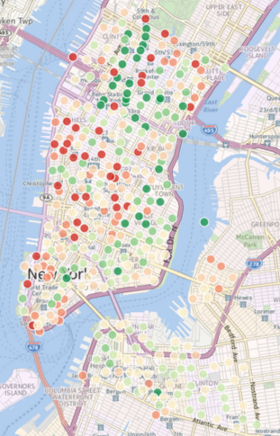
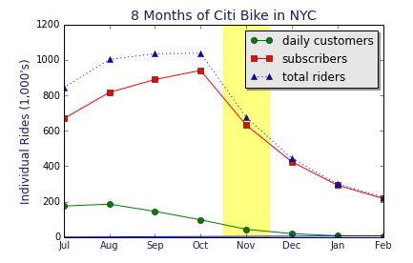
November
>1 million
rides

Slide 17
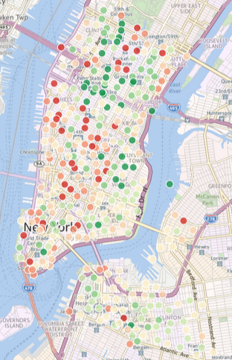
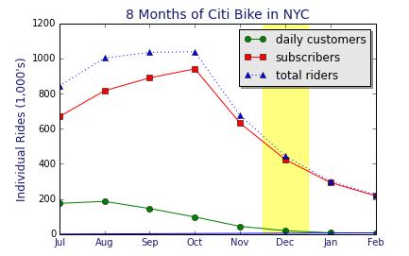
December
>1 million
rides

Slide 18
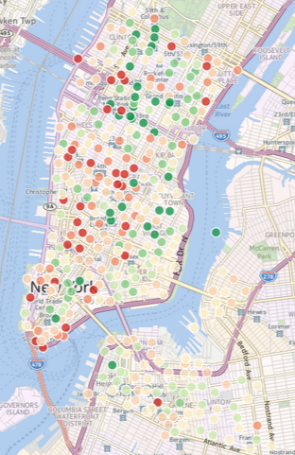
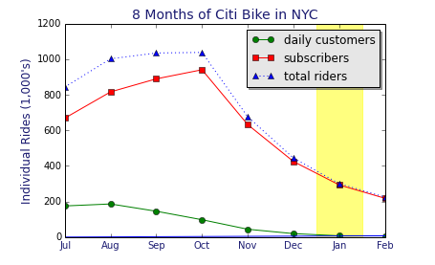
January
>1 million
rides

Slide 19
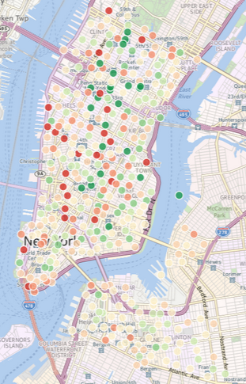
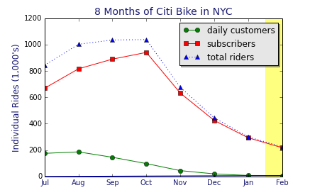
February
>1 million
rides

Slide 20
Total
>5 million
rides
Notes:
Here is the sum total across 8 months.
Next: To find out the story at each station.

Slide 21
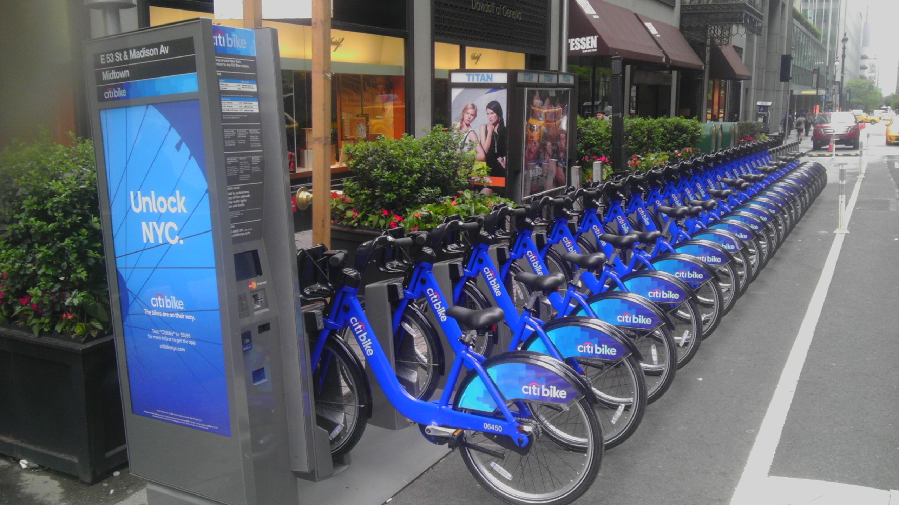
Mapping Traffic at Individual Bike Stations:
Challenges
How to process millions of lines of data?
Even processing a month (or even two weeks) at a time eventually crashes the iPython Notebook.
How to understand & visualize station traffic?
Notes:
Add at the end: With thousands of bikes and hundreds of stations in a very dense city, the task is expensive and difficult.

Slide 22
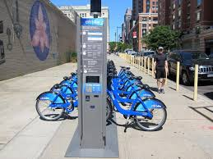
Mapping Traffic at Individual Bike Stations:
Solutions
Processing:
Process “big csv files” piecemeal.
Generate summary matrices.
Export to csv.
Interrupt. Reload. Repeat.
Visualizing station traffic:
Summarize big picture in broad strokes (as shown).
Average the details on a weekly schedule.
Notes:
Add at the end: With thousands of bikes and hundreds of stations in a very dense city, the task is expensive and difficult.

Slide 23
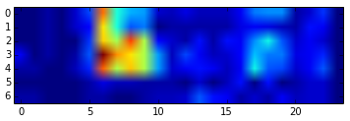
Initial Visualization:
Bikes going from station 492 by hour of week
plt.imshow(np.transpose(start492frame))
Notes:
Maybe create a few quick slides that more clearly show problems you addressed:
Interpolation = ‘nearest’ Show a fuzzy slide.
Color schemes = show slides like these.
Color scaling = show this more subtle issue with your station comparison.
Presentation of results = show different scaling (by hour, 3 hours, day, weekday/weekend)
Movements of bicycles at three stations in an average week.
Plus the sum of all three at the bottom.
However, the color scheme is not intuitive. (Don’t worry if you don’t understand.)

Slide 24
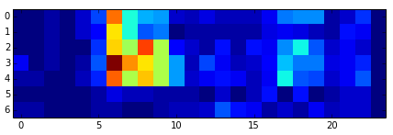
Initial Visualization:
Bikes going from station 492 by hour of week
plt.imshow(np.transpose(start492frame))
plt.imshow(np.transpose(start492frame), interpolation="nearest")
Notes:
Maybe create a few quick slides that more clearly show problems you addressed:
Interpolation = ‘nearest’ Show a fuzzy slide.
Color schemes = show slides like these.
Color scaling = show this more subtle issue with your station comparison.
Presentation of results = show different scaling (by hour, 3 hours, day, weekday/weekend)
Movements of bicycles at three stations in an average week.
Plus the sum of all three at the bottom.
However, the color scheme is not intuitive. (Don’t worry if you don’t understand.)

Slide 25
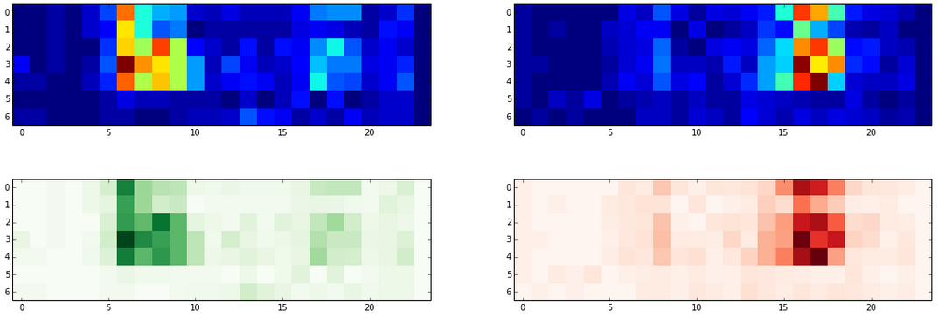
Color representation
of comings and goings
ax[0,0].imshow(sm492, interpolation='nearest')
ax[0,1].imshow(em492, interpolation='nearest')
Notes:
492 is right by Penn Station and sees 2000+ comings & goings per day. It’s relatively even (gains more than it loses.)

Slide 26
Color representation
of comings and goings
ax[0,0].imshow(sm492, interpolation='nearest')
ax[0,1].imshow(em492, interpolation='nearest')
Going from (cmap=‘Greens’)
Stopping at (cmap=‘Reds’)
Notes:
492 is right by Penn Station and sees 2000+ comings & goings per day. It’s relatively even (gains more than it loses.)

Slide 27
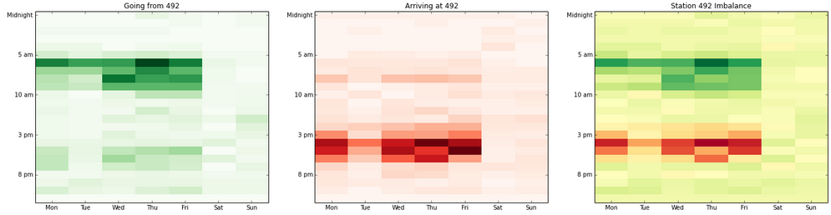
Station 492 departures by hour of week
Notes:
People are leaving between about 6 and 9 am Monday through Friday.
People leave early on Monday, but you can see the time of departure drifts by Wednesday – but more people are also biking in the morning later in the week.
Not many people leaving in the afternoon.

Slide 28
Station 492 arrivals by hour of week
Notes:
People ride to this station mostly in the afternoon Monday through Friday.

Slide 29
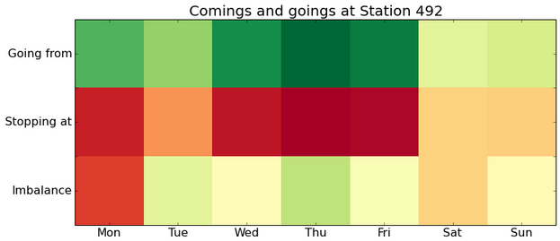
Weekly Summary (using cmap=‘RdYlGn’)
Notes:
If comings and goings per day are balanced , the bottom row is yellow.
It’s pretty imbalanced on a few days.
This station gains over 21 bicycles per Monday in the time frame I looked at. (These are from January, so it’s not like there’s a lot of traffic in general.)

Slide 30
Station 492 Summary
w/adjusted aspect ratio & labelling
Notes:
It looks pretty balanced with when people leave this station, but it’s actually hard to say.

Slide 31

Color Mapping Issues
Color maps scale to the entered data!
(0, 0, 1) = (0, 0, 10,000,000)
(0, 100, 200) = (432, 434, 436)
Max & min always depicted as extreme values.
Comparing colors between (& maybe within) graphs is virtually meaningless!
Red-Yellow-Green is not easy to interpret.
(See beige background.)
Notes:
1. No context is taken into account.

Slide 32

Color Mapping Solutions
Build my own red and green color maps.
LinearSegmentedColormaps
Write function to alter colormap according to data range.
(0, 0, 1) != (1, 1, 2) != (2, 2, 3)
Since rescaling the data has no effect, rescale the scale.
Create Red-White-Green.
Notes:
Start with all colors at or near max values → White
Drop out red and blue → Mid-green
Drop out green → Dark green

Slide 33
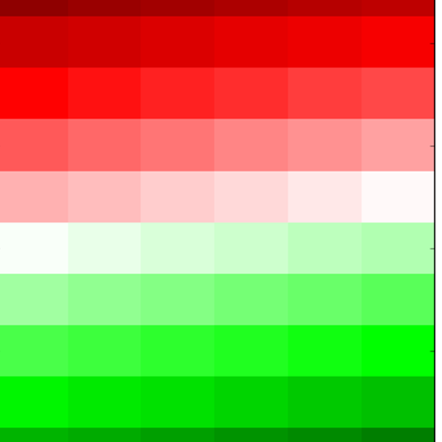
Coding Color Maps
“Red-White-Green”
cdictGR= {'red': ((0.0, 0.35, 0.35),
(0.25, 1.0, 1.0),
(0.5, 1.0, 1.0),
(0.75, 0.0, 0.0),
(1.0, 0.0, 0.0)),
'green': ((0.0, 0.0, 0.0),
(0.25, 0.0, 0.0),
(0.5, 1.0, 1.0),
(0.75, 1.0, 1.0),
(1.0, 0.25, 0.25)),
'blue': ((0.0, 0.0,0.0),
(0.25, 0.0, 0.0),
(0.5, 1.0, 1.0),
(0.75, 0.0, 0.0),
(1.0, 0.0, 0.0))}
Unicolor with variables
{'red': ((0.0, Crv[0], Crv[0]),
(Cset2, Crv[1], Crv[1]),
(1.0, Crv[2], Crv[2])),
'green':((0.0, Cgv[0], Cgv[0]),
(Cset2, Cgv[1], Cgv[1]),
(1.0, Cgv[2], Cgv[2])),
'blue': ((0.0, Cbv[0], Cbv[0]),
(Cset2, Cbv[1], Cbv[1]),
(1.0, Cbv[2], Cbv[2]))}

Slide 34
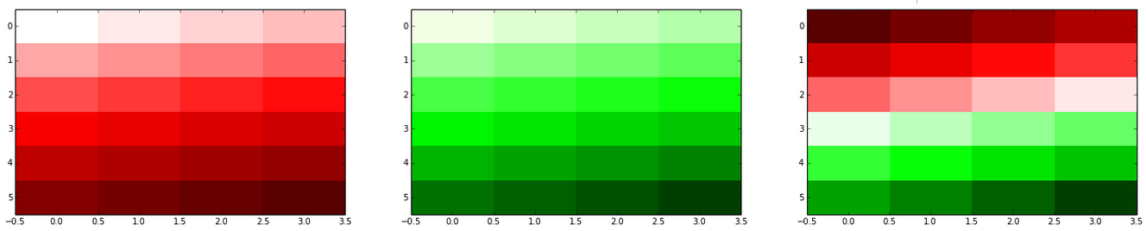
New color maps

Slide 35
New Color Maps: Station 519 vs. Station 119
Station 2021 is on W. 45th at 8th Ave.
Station 519 is right outside Grand Central Station.
2021
519
Notes:
Station 119 → E 11 Street (btwn 2nd & 1st Ave), New York, NY
Station 519 → Pershing Square N

Slide 36
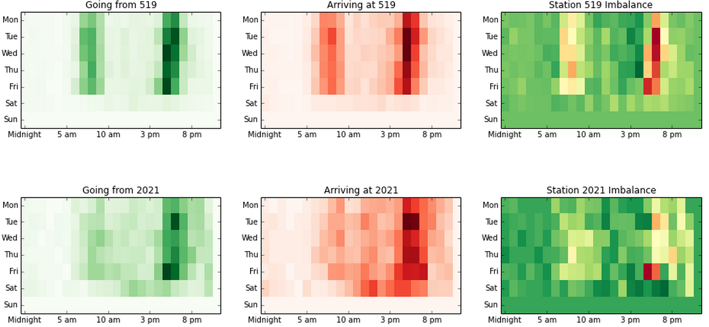
Summary report of 519 & 2021: Before
Notes:
Maybe switch from station 119 to some station that has more active timepoints.

Slide 37
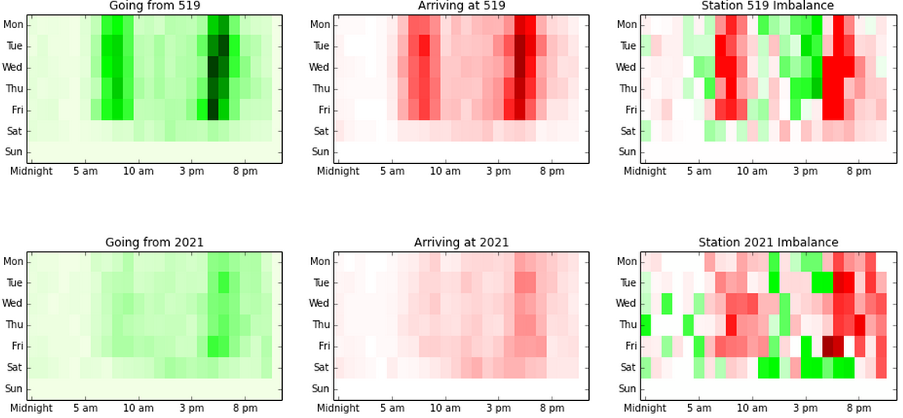
After: Optionally Scaled Contextually

Slide 38

Future Directions
Short-term riders: Analyze differences between short-term customers (mo’ $$$) and long-term subscribers to see if rebalancing can increase rentals.*
Color mapping: Complete automation of bi-directional colorbar & update color mapping programs to accurately depict a wider range of possibilities.*
Station Dictionary: Populate dictionary with station ID’s & count matrices to automate more of the data processing & storage processes.
Cluster analysis: Use cluster analysis to group stations by weekly movements (and possibly location).
Practical applications: Use these techniques to identify and respond to specific questions Citi Bike might have.
*Already started on this one.

Slide 39
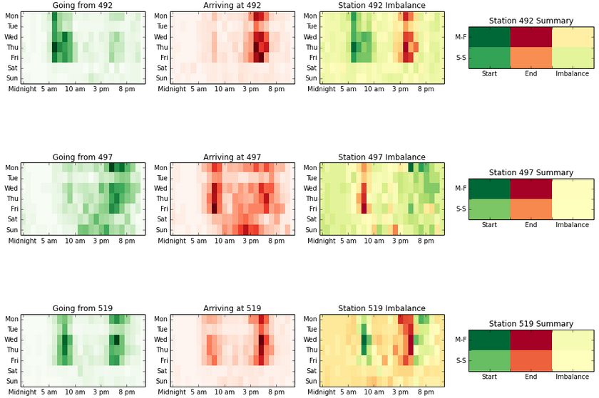
Color-Coded Station Summaries (3rd look)
Notes:
492 is right by Penn Station and gets 2000+ per day. It’s relatively even (gains more than it loses.)
497 is right by us! E. 17th & Broadway. It has huge volume, but gains tons of bikes per day.
519 has enormous volume & loses huge numbers of bikes (>>3000) every day. Riders go from station 519.

Slide 40
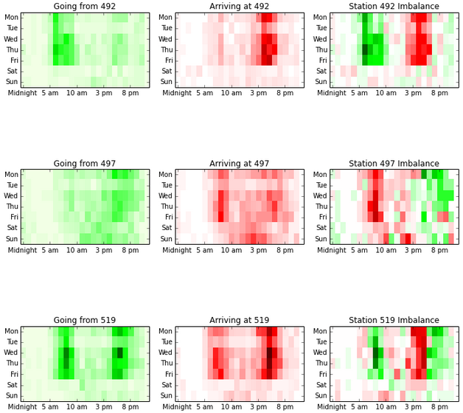
Color-Coded Station Summaries (3rd look)
Notes:
492 is right by Penn Station and gets 2000+ per day. It’s relatively even (gains more than it loses.)
497 is right by us! E. 17th & Broadway. It has huge volume, but gains tons of bikes per day.
519 has enormous volume (>>3000) & loses huge numbers of bikes every day. Riders go from station 519.

Slide 41
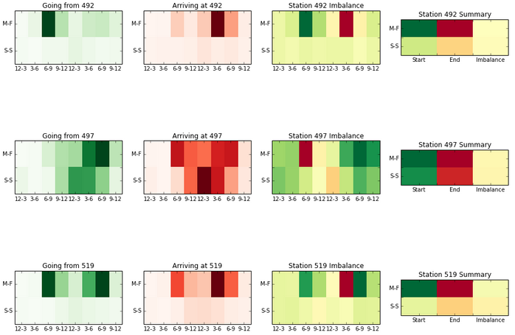
Color-Coded Station Summaries (1st look)
Notes:
519 loses enormous numbers of bikes every day. Bikes leave, but don’t come back.

Slide 42
Weekday/Weekend by 3-hour slots

Slide 43
Color-Coded Station Summaries (2nd look)
Notes:
492 is right by Penn Station and gets 2000+ per day. It’s relatively even (gains more than it loses.)
497 is right by us! E. 17th & Broadway. It has huge volume, but gains tons of bikes per day.
519 has enormous volume & loses huge numbers of bikes (>>3000) every day. Riders go from station 519.

Slide 44
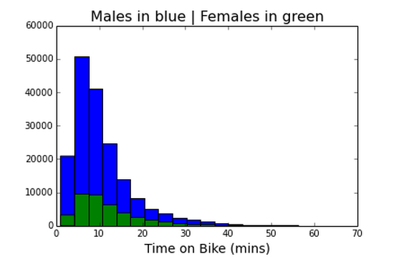
Time on Bike by Gender

Slide 45
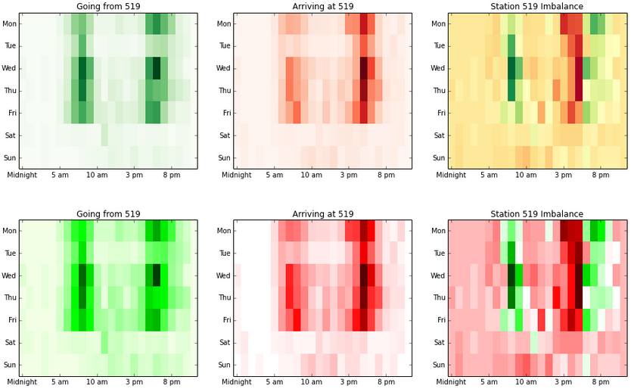
New Color Maps: Before and after

